Slide 1
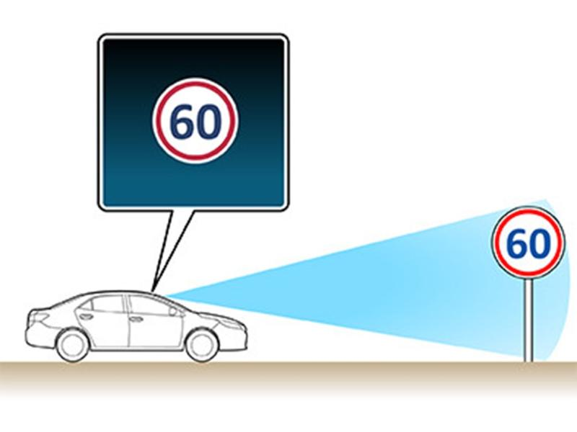
Traffic Signs Recognition Using Artificial Neural Networks and Convolutional Neural Networks

Slide 2

Problem Statement
Accurately recognizing traffic signs is crucial for autonomous driving and advanced driver assistance systems (ADAS) However, traditional computer vision methods struggle with accuracy and real-time performance due to lighting, weather, and occlusions. Developing robust models for automated traffic sign recognition is essential for road safety and advancing autonomous vehicles

Slide 3
Dataset Description
The dataset consists of images representing the standard traffic signs used in the German traffic system.
It comprises a total of 51,841 images, with 39,209 train images and 12,632 test images categorized into 43 classes corresponding to different types of traffic signs.
Each image is annotated with the appropriate class label, facilitating supervised learning.

Slide 4
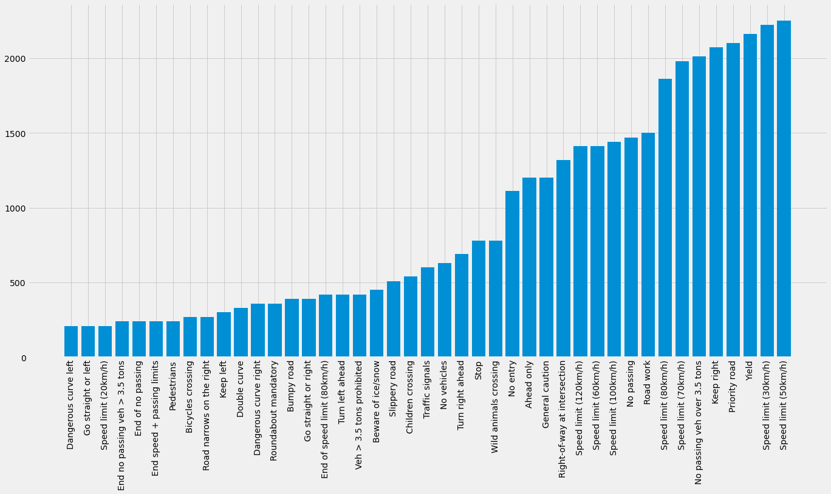
Class Distribution

Slide 5
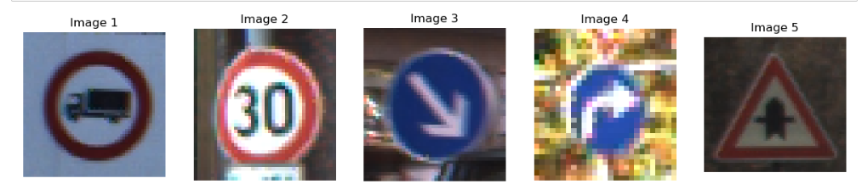
Sample Images from dataset

Slide 6
Workflow
1. Importing the necessary libraries dataset.
2. Preprocessing: Apply preprocessing techniques such as resizing, normalization, and augmentation to prepare the images for model training.
3. Splitting the data: Divide the dataset into training, validation, and testing sets to train and evaluate the models.
4. Building ANN model: Construct an Artificial Neural Network (ANN) model architecture suitable for traffic sign recognition.
5. Building CNN model: Design a Convolutional Neural Network (CNN) model architecture tailored for traffic sign recognition tasks.
6. Comparing the results: Evaluate the performance of both models based on accuracy.
7. Predicting test data on best algorithm: Deploy the best-performing model to predict traffic signs on the testing dataset and analyze the predictions' accuracy and reliability.

Slide 7
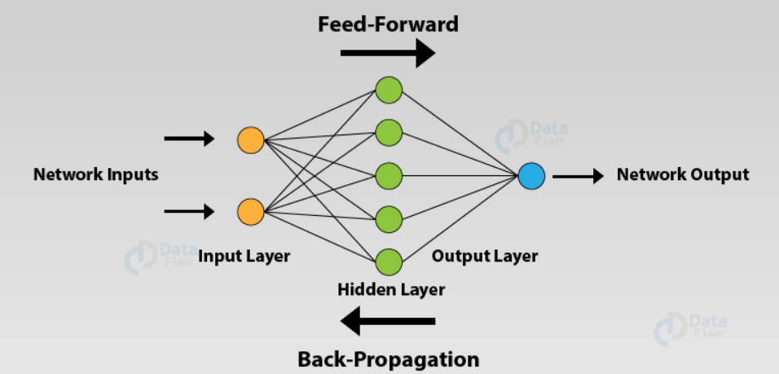
Artificial Neuron Networks

Slide 8
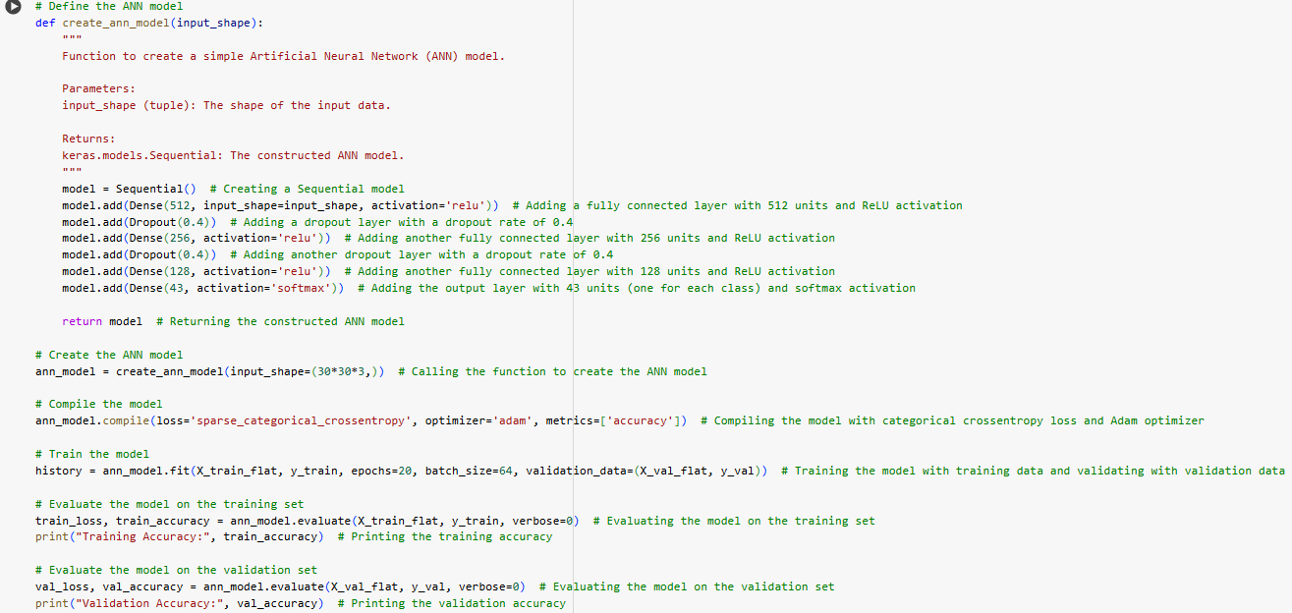
ANN Code

Slide 9
Steps followed in ANN
1.Define the architecture of the ANN model:
Three dense layers with 512, 256, and 128 units, respectively.
ReLU activation function for all hidden layers.
Dropout layers with a dropout rate of 0.4 after each dense layer to prevent overfitting.
Output layer with 43 units (number of classes) and softmax activation function for multiclass classification.
2. Hyperparameters Used:
Loss function: Sparse categorical cross-entropy.
Optimizer: Adam optimizer.
Metrics: Accuracy.
Number of epochs: 20.
Batch size: 64.
3. Compile the model with the specified loss function, optimizer, and metrics.
4. Train the model on the training data for 20 epochs with a batch size of 64, utilizing the validation data for monitoring.
5. Evaluate the trained model's accuracy on both the training and validation datasets to assess its performance

Slide 10
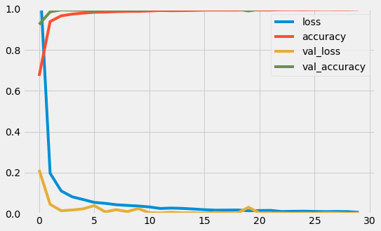
Results of ANN
Training Accuracy: 83.60%
Validation Accuracy: 82.01%

Slide 11
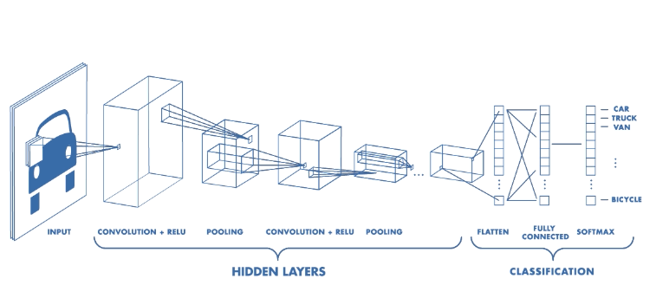
Convolution Neural Network (CNN)

Slide 12
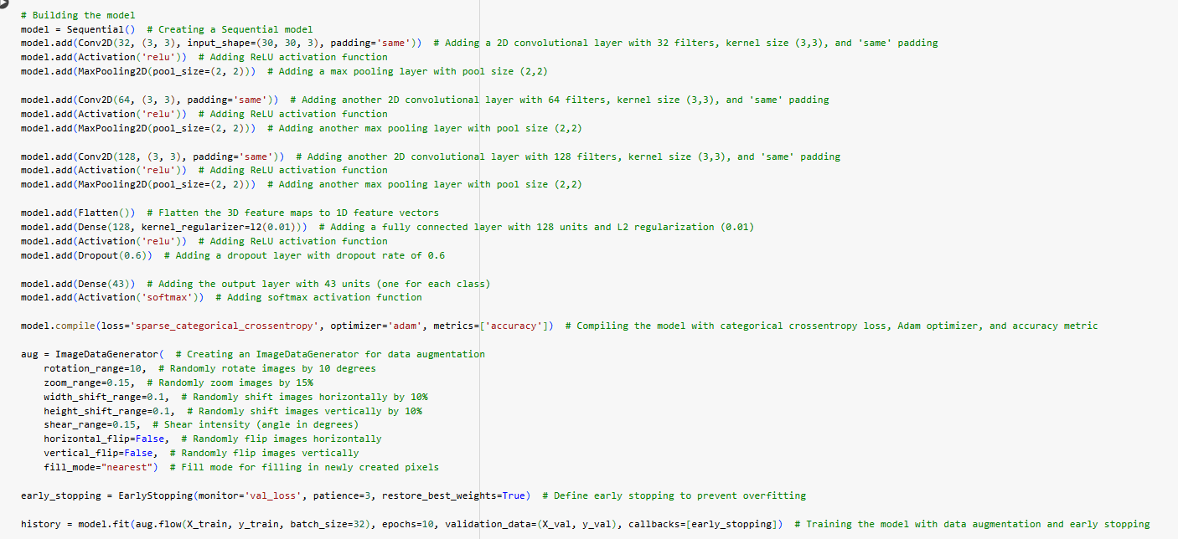
CNN Code

Slide 13
Steps followed in CNN
1. Building the CNN model architecture:
Convolutional layers with 32, 64, and 128 filters, respectively, each followed by ReLU activation and max pooling.
Flatten layer to convert 3D feature maps to 1D feature vectors.
Dense layer with 128 units, incorporating L2 regularization and ReLU activation, followed by dropout.
Output layer with 43 units (number of classes) and softmax activation for multiclass classification.
2. Hyperparameters Used:
Loss function: Sparse categorical cross-entropy.
Optimizer: Adam optimizer.
Metrics: Accuracy.
Number of epochs: 10.
Batch size: 32.
Data augmentation: Rotation, zoom, width and height shift, shear, with horizontal and vertical flip disabled.
3. Compile the model with the specified loss function, optimizer, and metrics.
4. Train the model using augmented training data generated by ImageDataGenerator, with early stopping applied to prevent overfitting.
5. Evaluate the trained model's accuracy and loss on both the training and validation datasets to assess its performance.

Slide 14
Results of CNN
Training Accuracy: 97.96%
Validation Accuracy: 97.86%

Slide 15
Prediction on Test Dataset
Developed a function to predict German traffic signs from input images using a trained model.
Utilized image preprocessing and visualization tools from Keras and Matplotlib.
Invoked the model to predict the class label of the input image.

Slide 16
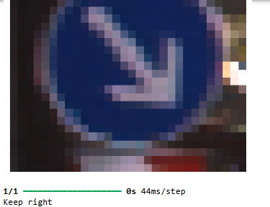
Prediction on Test Dataset

Slide 17
Conclusions
The Convolutional Neural Network (CNN) exhibited superior performance over the Artificial Neural Network (ANN) in recognizing German traffic signs.
CNNs can understand different levels of details in images, leading to more accurate predictions and improved performance on various tasks.
CNN emerges as the preferred model for automated traffic sign recognition systems

Slide 18

Real World Applications
1. Autonomous Vehicles: Enable safe navigation by interpreting traffic signs.
2. Advanced Driver Assistance Systems (ADAS): Aid drivers with real-time sign recognition.
3. Traffic Management: Assist in monitoring and controlling traffic flow.
4. Road Safety: Enhance safety by alerting drivers to hazards and enforcing regulations.
5. Smart Cities: Integrate into intelligent transportation systems for urban mobility.
6. Fleet Management: Monitor driver behavior and optimize routes for efficiency and safety.

